Slide 1

Harmonic Mean:-
The harmonic mean is a type of numerical average. It is calculated by dividing the number of observations, or entries in the series, by the reciprocal of each number in the series. Thus, the harmonic mean is the reciprocal of the arithmetic mean of the reciprocals.
For example, to calculate the harmonic mean of 1, 4, and 4, you would divide the number of observations by the reciprocal of each number, as follows:
The harmonic mean is appropriate if the data values are ratios of two variables with different measures, called rates.

Slide 2
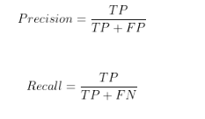
Precision: Of all positive predictions, how many are really positive?
Recall: Of all real positive cases, how many are predicted positive?
Precision and the recall are "naturally" reciprocals because their numerator is the same and their denominators are different. Fractions are more sensible to average by arithmetic mean when they have the same denominator.

Slide 3
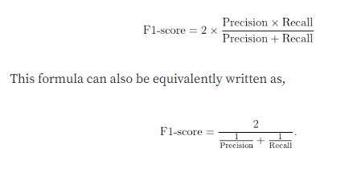
By definition, F1-score is the harmonic mean of precision and recall. It combines precision and recall into a single number using the following formula:

